Slide 1

DS Project Review-3
Finsight-Loan/Credit Risk Analyzer4
16-10-2026 & 8:15-9:50
 | Under the Guidance of DR. N.SUNANDA Assistant Professor, Department of Computer Science and Engineering, KLH CSE Bowrampet Campus
Team Members Moukshitha 2420030164 Hasini 2420030421

Slide 2

Outline of Project Work
Focus
Introduction
Literature Survey
Challenges
Research Objectives
Conclusion & Future Work
References
Publications Details

Slide 3
Problem Statement
Traditional loan and credit evaluation methods often struggle to accurately assess borrower risk due to complex financial and behavioural factors. This can lead to incorrect lending decisions, increased loan defaults, and financial losses. Therefore, there is a need for a data-driven and reliable credit risk analysis system that can analyse borrower information, predict the likelihood of loan default, and classify applicants into appropriate risk categories to support better and more responsible lending decisions.

Slide 4
Objectives
To analyse historical borrower and loan data to identify credit-risk patterns.
To preprocess and transform financial data for effective analysis.
To develop machine learning models for predicting loan default risk.
To classify applicants into different risk categories based on predicted risk.
To compare model performance using standard evaluation metrics.
To support accurate, data-driven, and responsible lending decisions.

Slide 5
Literature Survey
Authors | Title of the Paper | Methodology | Inferences | Limitation/Future work
Hilal et. al. [3] | Intelligent Epileptic Seizure Detection and Classification Model Using Optimal Deep Canonical Sparse Autoencoder, Biology, 2022-mdpi | Coyote optimization algorithm (COA) for feature selection Krill herd algorithm (KHA) for parameter tuning | intelligent deep canonical sparse autoencoder-based epileptic seizure detection and classification model using EEG signals. It achieves a maximum accuracy of 98.67% and 98.73% under binary and multi-classification, respectively. | The paper does not mention the specific limitations of the proposed DCSAE-ESDC technique or the experimental analysis conducted using the benchmark epileptic seizure dataset
Baek & Kim [1] | A Comparative Assessment of Credit Risk Model Based on Machine Learning – A Case Study of Bank Loan Data (2020) | Logistic Regression Decision Tree Random Forest Naive Bayes & KNN | Compared 5 ML classifiers for credit scoring. Random Forest performed best in precision, recall, AUC and accuracy. | Focuses mainly on model comparison. Further work can explore more advanced and explainable models.
Dumitrescu et al. [2] | Machine Learning for Credit Scoring: Improving Logistic Regression with Non-linear Decision-tree Effects (2022) | Logistic Regression Decision-tree-based feature engineering Penalised Logistic Tree Regression | Combines interpretability of Logistic Regression with nonlinear patterns from decision trees. Improves credit-risk prediction. | More complex than standard Logistic Regression. Further research can improve interpretability and practical deployment.

Slide 6
Problem Gap Identification
Traditional loan assessment methods often rely on limited borrower information and predefined rules.
They may fail to identify complex patterns in borrowers’ financial and repayment behavior.
This can lead to inaccurate risk assessment, increased loan defaults, and financial losses.
Existing approaches may focus mainly on prediction without providing clear risk categorization and actionable insights.
Therefore, an integrated data-driven and machine learning-based credit risk analyzer is needed to improve loan-risk assessment and support responsible lending decisions.

Slide 7
Innovation, Creativity, and Novelty
Data-Driven Risk Assessment: Uses borrower and loan data to identify hidden patterns in credit risk.
Multiple ML Models: Compares Logistic Regression, Decision Tree, and Ensemble Models to select an effective prediction approach.
Risk Categorization: Classifies applicants into different risk levels instead of providing only a loan default prediction.
Actionable Insights: Converts model predictions into meaningful information to support lending decisions.
Integrated Analytics: Combines data preprocessing, EDA, machine learning, and risk analysis in a single system.
Scalable Approach: Can be adapted to different lending environments and datasets.

Slide 8
Feasibility and Project Plan
Feasibility
Technical: Uses Python, Pandas, Scikit-learn, and visualization tools that are widely available and easy to implement.
Data: Historical loan/credit datasets are available for training and evaluation.
Economic: Requires minimal cost as the project mainly uses open-source tools and datasets.
Operational: Simple and user-friendly system that can provide quick credit-risk insights.
Project Plan
Data Collection & Preprocessing
EDA & Feature Engineering
ML Model Development
Model Evaluation & Comparison
Risk Prediction & Dashboard
Testing, Documentation & Final Deployment

Slide 9
Proposed Methodology
The proposed system uses machine learning techniques to analyse borrower information and predict loan or credit default risk.
Data Collection: Collect historical loan and credit data from publicly available datasets.
Data Preprocessing: Handle missing values, duplicate records, categorical variables, and inconsistent data.
Exploratory Data Analysis (EDA): Identify patterns and relationships between borrower details and loan defaults.
Feature Engineering: Select relevant features that influence credit risk.
Model Development: Train multiple machine learning algorithms using the prepared dataset.
Model Evaluation: Compare the models using standard evaluation metrics.
Risk Classification: Categorize applicants into suitable risk levels based on model predictions.
Dashboard Development: Present predictions and risk-related insights through a user-friendly interface.

Slide 10
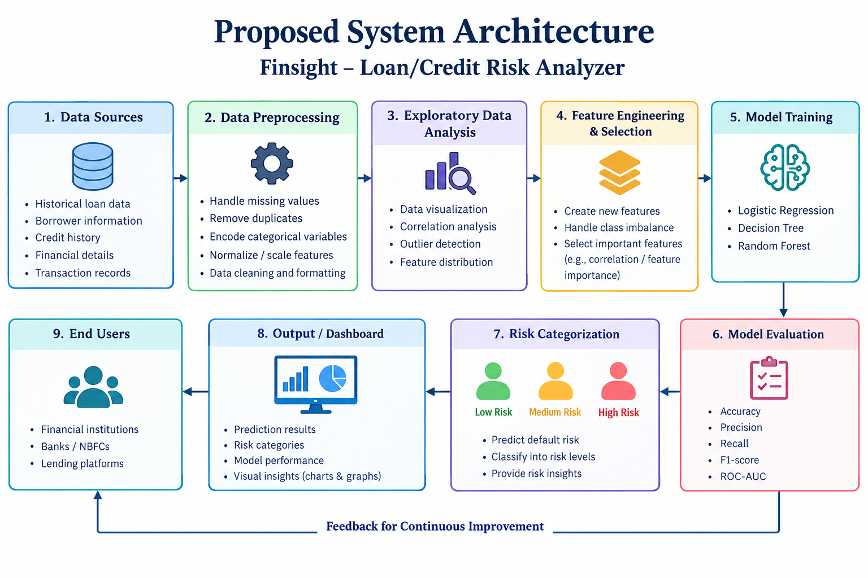

Slide 11
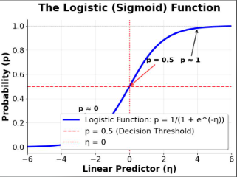
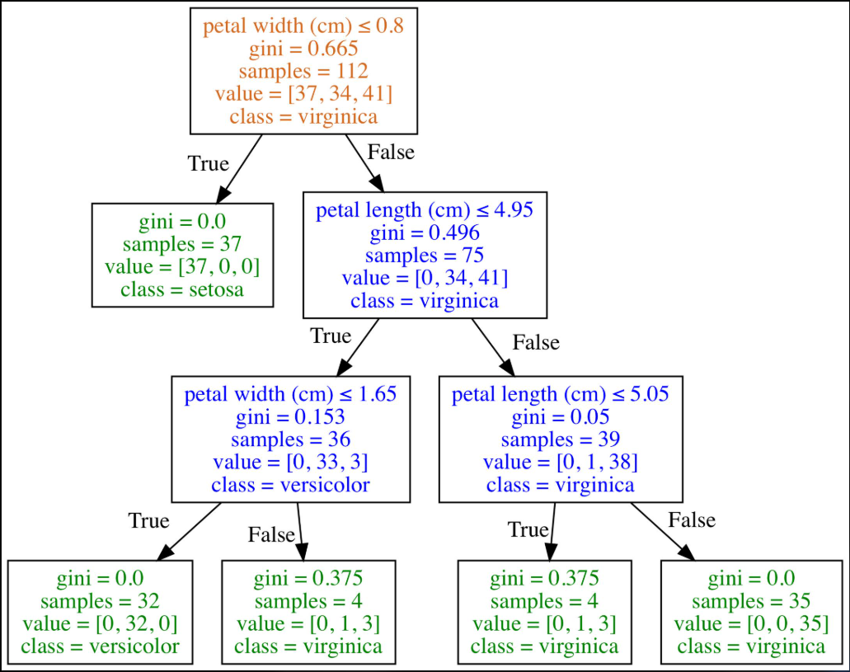
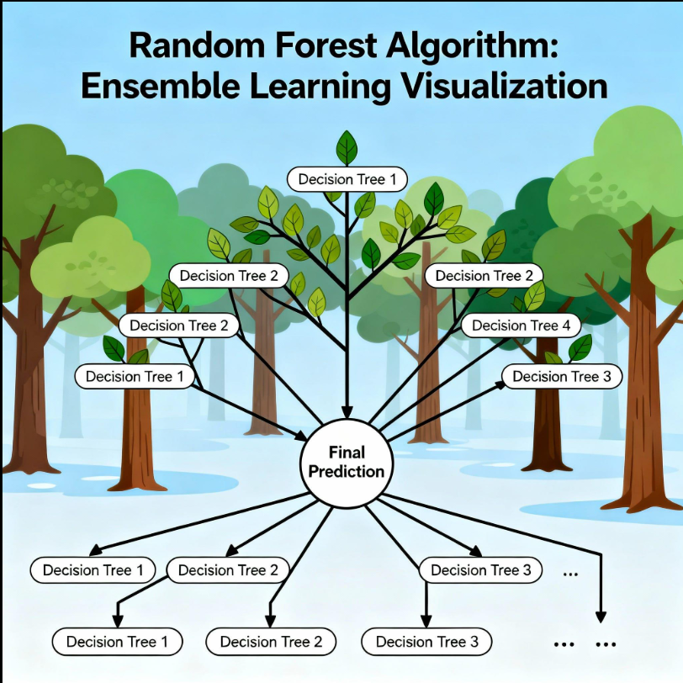
Algorithms Used
1. Logistic Regression
Predicts the probability of loan default using borrower and loan features. It provides a simple and interpretable baseline for binary classification.
2. Decision Tree
Uses a tree-like structure of conditions to classify applicants. It captures nonlinear relationships and is easy to interpret.
3. Random Forest
Combines predictions from multiple decision trees. It can capture complex patterns and often provides more robust predictions than a single tree.

Slide 12
Implementation Details
Tools and Technologies
Programming Language: Python
Data Processing: Pandas and NumPy
Machine Learning: Scikit-learn
Data Visualization: Matplotlib and Seaborn
Dataset: Publicly available loan or credit-risk dataset
Implementation Steps
Load the dataset into Python.
Inspect the dataset and identify missing or inconsistent values.
Clean the data and encode categorical features.
Perform exploratory data analysis using charts and statistical summaries.
Divide the dataset into training and testing sets.
Train Logistic Regression, Decision Tree, and Random Forest models.
Evaluate each model using classification metrics.
Use the selected model to generate risk predictions.
Display risk categories and analytical insights through a dashboard.
The implementation is designed to provide a structured workflow from raw loan data to interpretable credit-risk predictions.

Slide 13
Risk Categorization and Expected Output
The system will use the selected machine learning model to predict whether a borrower is likely to default.
Expected Output
Borrower and loan information
Predicted default probability, if supported by the selected model
Risk category such as Low Risk, Medium Risk, or High Risk
Model evaluation results
Graphical representation of credit-risk patterns
Risk Categorization Approach
Risk levels can be assigned using predefined probability thresholds, which should be selected and validated during implementation. These categories are intended to support lending analysis and should not independently determine loan approval.
Expected Benefit: Helps identify potentially risky applications, understand borrower patterns, and support more informed lending decisions.

Slide 14
Conclusion and Future Work
Finsight – Loan/Credit Risk Analyzer aims to improve credit-risk assessment using data analysis and machine learning. The proposed system combines data preprocessing, exploratory analysis, model comparison, and risk categorization to support better-informed lending decisions.
Future Work
Improve model performance through hyperparameter tuning.
Explore additional borrower and repayment features.
Improve model interpretability.
Develop an interactive dashboard for users.
Test the system on additional datasets and real-world scenarios.

Slide 15
TIMELINE
Phase | W1 | W2 | W3 | W4
Data Collection | ✓
Preprocessing |  | ✓
EDA & Features |  | ✓ | ✓
ML Models
Evaluation
Dashboard

